Slide 1
Innovation Idea One innovative idea for a smart parking system using IoT is to develop a real-time parking availability and reservation system. Here's how it could work:

Slide 2
Sensors and Cameras: Install IoT sensors and cameras in each parking space to monitor occupancy and collect data.
Mobile App: Create a mobile app for users to check real-time parking availability, reserve a spot, and pay for parking

Slide 3
Data Analysis: Use machine learning algorithms to analyze data from sensors and cameras to predict parking availability based on historical patterns.
Reservation System: Allow users to reserve a parking spot in advance through the app, ensuring a guaranteed space upon arrival.

Slide 4
Navigation Assistance: Integrate GPS navigation into the app to guide users to their reserved parking space.
Payment Integration: Enable cashless payments through the app, automatically charging users based on their parking duration.

Slide 5
Accessibility: Make the system accessible for people with disabilities, providing designated accessible parking spots and features like voice commands for the app.
Sustainability: Implement eco-friendly features like solar-powered sensors and electric vehicle (EV) charging stations.

Slide 6
Alerts and Notifications: Send users notifications about their reserved parking space, upcoming expiration, and available discounts.
Data Sharing: Share parking data with city authorities to optimize traffic flow and reduce congestion.

Slide 7
This smart parking system would enhance the overall parking experience, reduce traffic congestion, and promote sustainability through efficient space management.

Slide 8
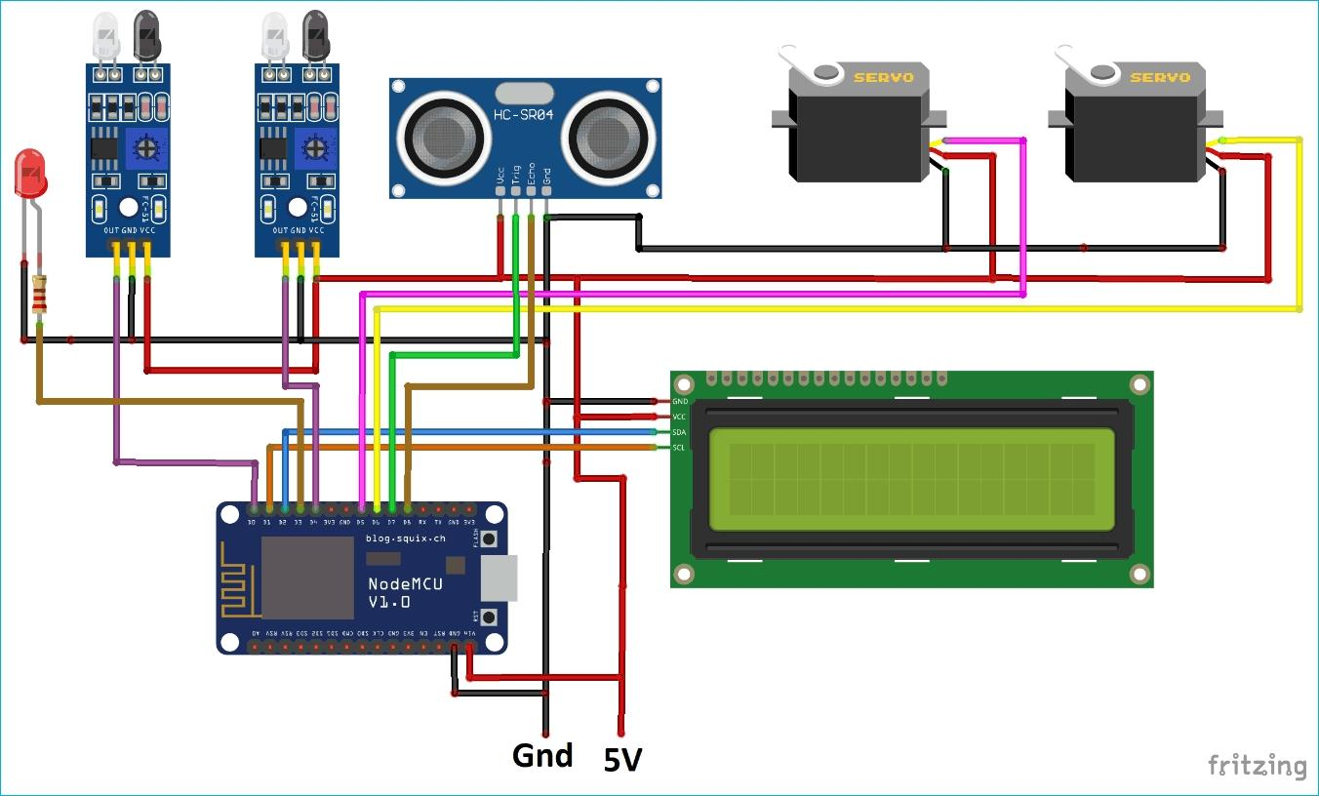
Design model of smart parking This device is designed using raspberry pi.This device consists of ultra Sonic sensor for measure the distance and detect the presence of object.This helps to detect the any object present infront and nearest of that device and give warning signal to the user.

Slide 9
Program for circuit:
import RPi.GPIO as GPIO
import time
# Set GPIO pins for sensor
TRIG = 23
ECHO = 24
# Set GPIO pin for LED
LED = 18
# Setup GPIO
GPIO.setmode(GPIO.BCM)
GPIO.setup(TRIG, GPIO.OUT)
GPIO.setup(ECHO, GPIO.IN)
GPIO.setup(LED, GPIO.OUT)

Slide 10
def measure_distance():
# Trigger sensor
GPIO.output(TRIG, True)
time.sleep(0.00001)
GPIO.output(TRIG, False)
# Measure time for echo
while GPIO.input(ECHO) == 0:
pulse_start = time.time()
while GPIO.input(ECHO) == 1:
pulse_end = time.time()
# Calculate distance
pulse_duration = pulse_end - pulse_start
distance = pulse_duration * 17150
return distance

Slide 11
try:
while True:
dist = measure_distance()
if dist < 10: # Adjust this threshold for your setup
GPIO.output(LED, GPIO.HIGH) # LED ON
else:
GPIO.output(LED, GPIO.LOW) # LED OFF
except KeyboardInterrupt:
GPIO.cleanup()

